Slide 1
Establishment of a National Respiratory Virus Cryobank in the Czech Republic to Enhance Public Health Surveillance and Ensure Rapid Response to Disease Outbreaks in the Context of Ukrainian Crisis Part 2
NRL pro chřipku a nechřipková respirační virová onemocnění, CEM
National Respiratory Virus Cryobank is a long-term project, which could have been launched thanks to WHO support in 2023 and 2024.
The purpose of this project was to purchase items to complete a fully functional archiving system.
Purchased items will serve for a long-term, modern systematic way of archiving.

Slide 2
Objective 1:
Finalization of the set of equipment to achieve the goals specified in the previous project covering period 1.11.-15.12.2023 consisting of the procurement of supplementary hardware
2 freezers (-20°C): delivered
2 refrigerators (4°C): delivered
CO₂ incubator: delivered
container for liquid nitrogen: delivered
system for the automatic extraction of nucleic acid: delivered
furniture for the NRL CH/NCH for the renovation of a laboratory dedicated for antigenic characterization of influenza strains and laboratory for the isolation of influenza strains and for the placement of computers and specific items of the archive (laboratory furniture – tables, chairs, storage cupboards and shelves): delivered
database specialist and IT support service procurement: canceled

Slide 3
Objective 2:
Finalization of the archival database and its connectivity to ensure effective connection of LIS and archival database.
Due to the acquisition of a new LIS for the entire NIPH (2025), the need to modify the communication of the existing LIS with the archiving system was eliminated. This objective is therefore postponed until new LIS is purchased. As a result of this unexpected change, there were remaining CZK 250,000 incl. VAT, which is why we asked to move this amount from the IT category to the medical equipment category.
Due to the cheaper purchases of all individual items, we had an additional approx. CZK 203,000 incl. VAT remaining in the medical equipment category.
After consultation with the WHO office, we were allowed to use this budget of CZK 453,000 incl. VAT for the purchase of
additional laboratory equipment for archive (Tab 1):

Slide 4
Additional laboratory equipment for archive:
Biohazard
for the cell culture laboratory, which will ensure the supply of cell cultures for the isolation of viruses stored in the archive:
delivered
Incubator for chicken embryos
is used for isolation of influenza viruses for subsequent storage of influenza viruses in the archive: delivered
Automatic pipettes
laboratory instruments to measure out or transfer small quantities of liquid, in volumes of milliliters (mL), microliters (μL) in the process of virus isolation on tissue cultures and chicken embryos and subsequent storage of viruses in the archive. delivered

Slide 5
Tab 1: Original and updated budget
Numbe r | Item | Number of items | Total cost estimated with VAT (original plan) CZK | Total cost with VAT (updated plan) CZK
1 | Freezer - 20°C , 350 - 500 l | 2 | 193 600,00 | 138 520,80
2 | Refrigerator, cca 350-500 l | 2 | 208 120,00 | 148 200,80
3a | CO₂ incubator for cell cultures | 1 | 326 700,00 | 235 072,75
3b | CO₂ incubator/1st floor placement |  |  | 9 922,00
4 | Cryogenic container (Liquid nitrogen Dewar tank) | 1 | 242 000,00 | 235 345,00
5 | Nucleic acid Extraction System | 1 | 360 580,00 | 278 300,00
6 | Laboratory furniture set (table, chair, storage cupboard, set of shelves) | 35 | 280 719,94 | 275 771,58
7 | Database Adaptation IT service | 1000 | 250 470,00 | 0
8 | Biohazard box | 1 | Newly added item | 372 680,00
9 | Incubator for eggs | 1 | Newly added item | 27 161,00
10 | Pipettes | 13 pieces total | Newly added item | 141 216,00
 | TOTAL |  | 1 862 189,94 | 1 862 189,93
Procurement of health-related supplies and equipment: medical equipment (incl. furniture) | 1 611 720,00
Procurement of health-related supplies and equipment: medical equipment (incl. furniture) | 250 470,00
Procurement other than health related: IT & telecommunication equipment | 250 470,00
TOTAL CZK (with VAT) | 1 862 190,00

Slide 6
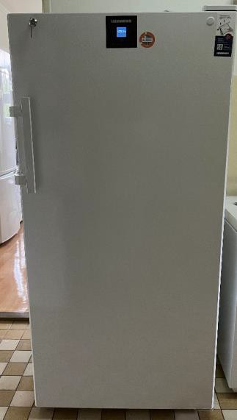
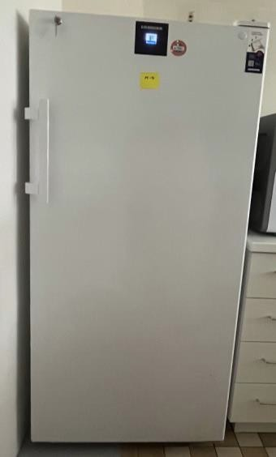
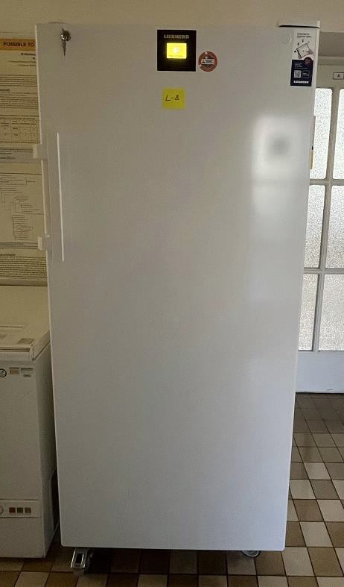
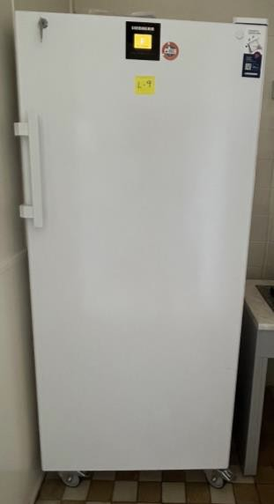
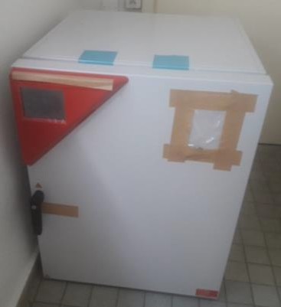
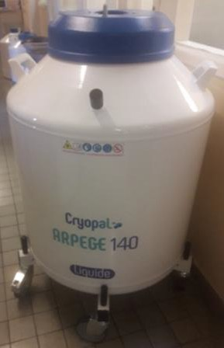
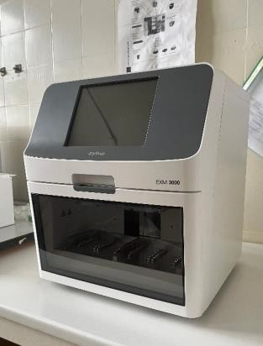
Freezers (2p, M4)
Refrigerators (L8, L9)
CO₂ incubator for cell cultures
Cryogenic container
Nucleic acid extraction system

Slide 7
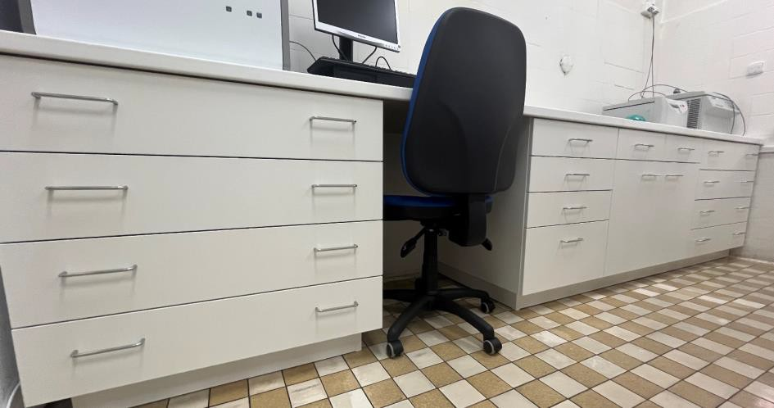
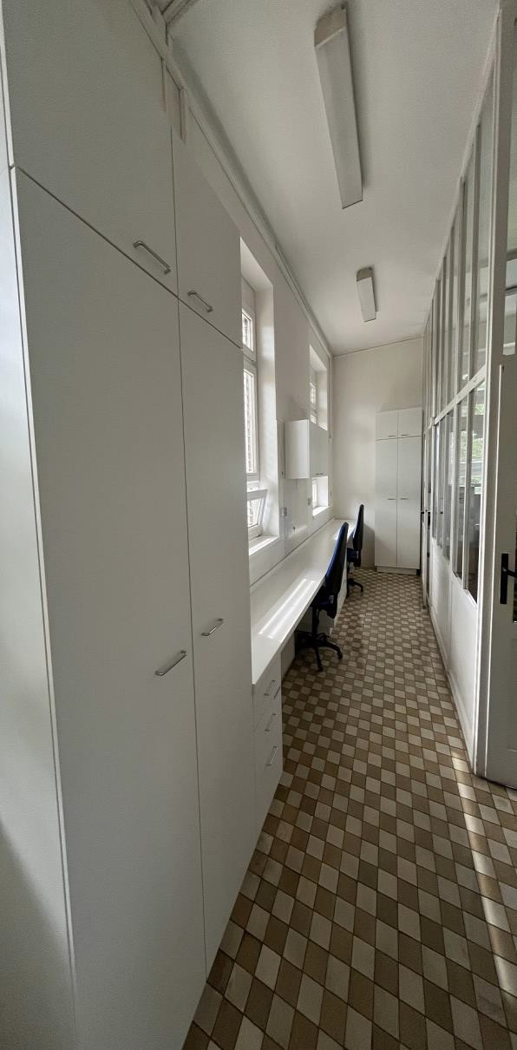
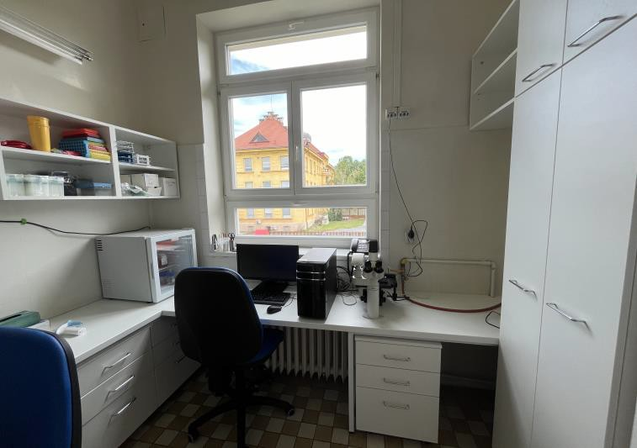
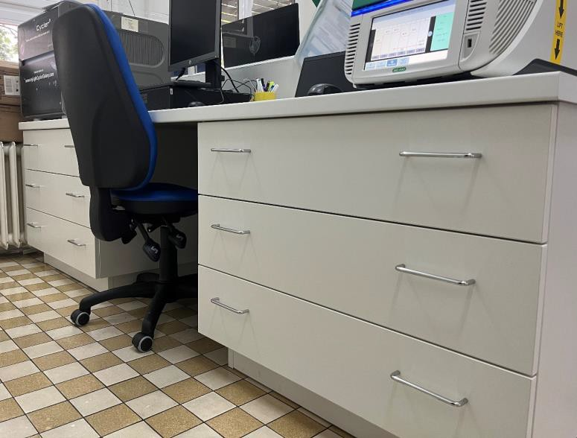
Laboratory furniture
Laboratory 7:
used for archive scaners, pickers, computers with SW
Laboratory 9 used for
antigenic characterization of infl. viruses and other strains isolation of influenza viruses and other strains on tissue culture
Laboratory 5
used for molecular characterization of influenza strain as well as various pathogens

Slide 8
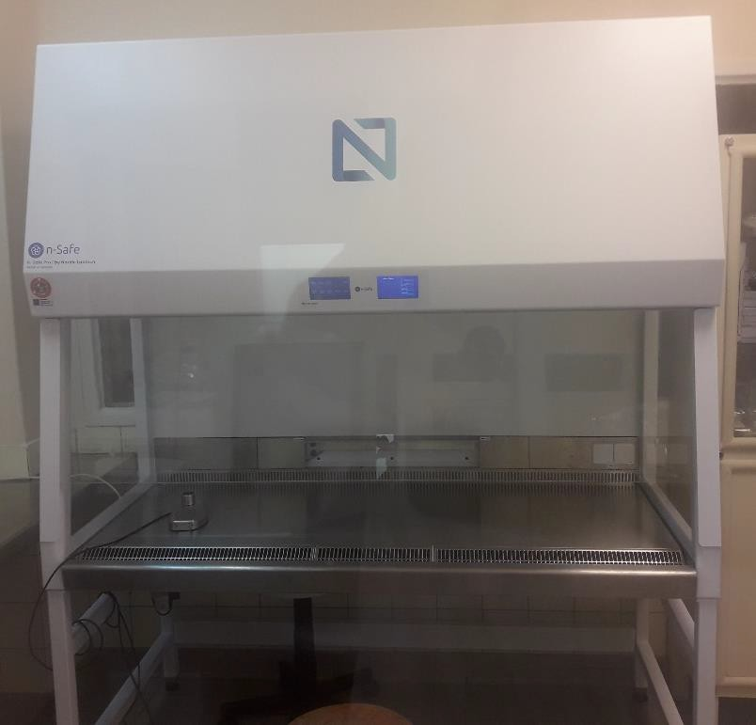
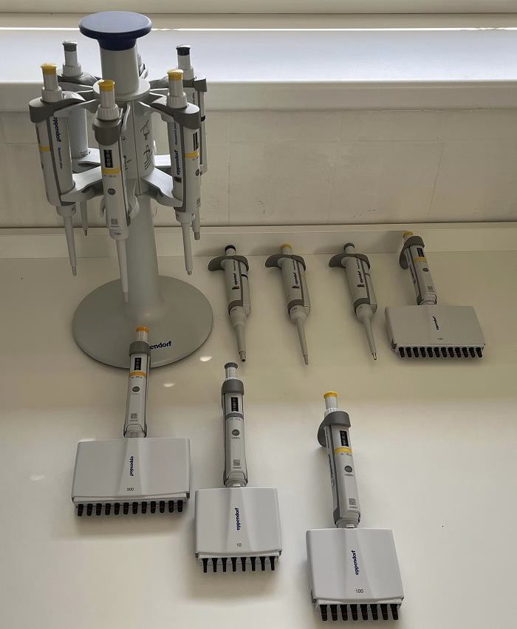
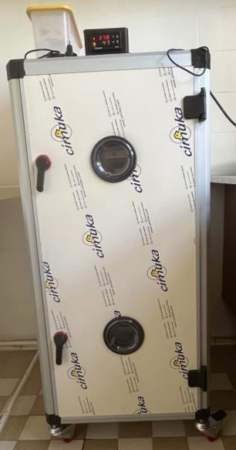
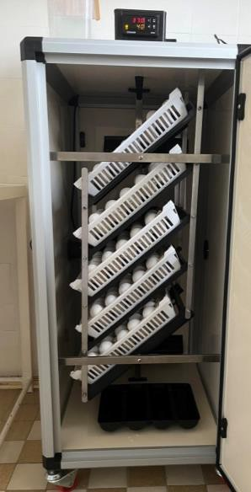
Biohazard box
Incubator for eggs
Pipettes

Slide 9
Děkujeme za pozornost

