Slide 1





The national reference laboratory for mycobacteria
Ing. Věra Dvořáková, Ph.D. (head of NRLM) (Ing. Michaela Hromádková) MUDr. Jana Kozáková (head of department and head of CEM) The National Institute of Public Health

Slide 2

NRLM
HEAD OF nrlm:
Ing. Věra Dvořáková, Ph.D.
Professional staff:
Ing. Michaela hROMÁDKOVÁ
Laboratory workers: Lucie Rosová, Miluše Kučerová, Iveta Adamuščinová and Miluše Šperková
tel: 267 082 424, 307
e-mail: vera.dvorakova@szu.cz

Slide 3

Basic data sheet
Name of Organization: | National institute of public health, Czech republic
Name of Project: | DFC Project on Modernization Reference laboratory for Mycobacteria for Enhanced Tuberculosis Diagnosis and Monitoring
Sub-Agreement #:
Time Period of Agreement: | 15.3.2024 – 10.6.2024
Country: | Czech republic
Site(s)/Location(s): | Prague, Srobarova 49/48
Primary Point of Contact/Title: | Ing. Věra Dvořáková
Phone Number: | +420 267 082 307
E-Mail Address: | vera.dvorakova@szu.cz, michaela.hromadkova@szu.cz
Submission Date of Report: | 3.7.2024
Time Period Covered by Report: | 15.3.2024-10.6.2024

Slide 4
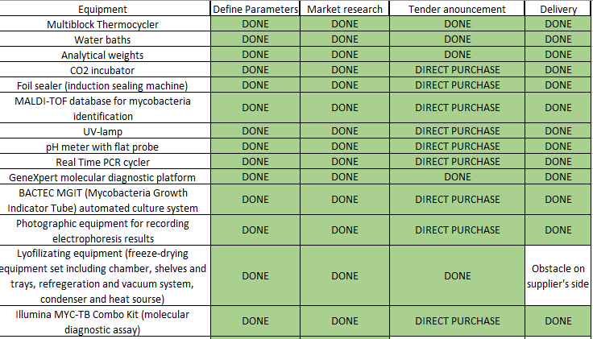

Slide 5
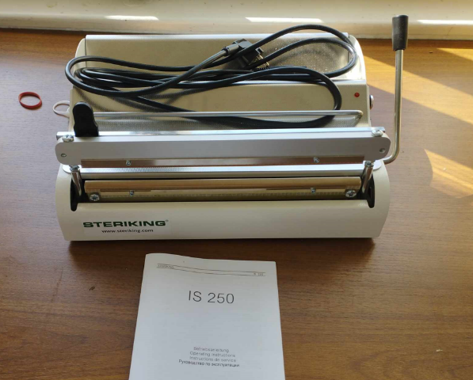
Foil sealer

Slide 6
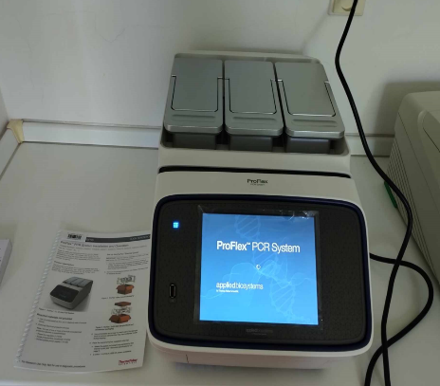
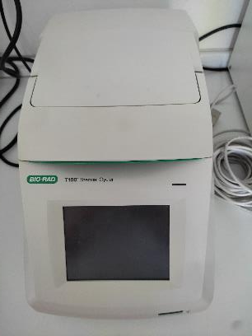
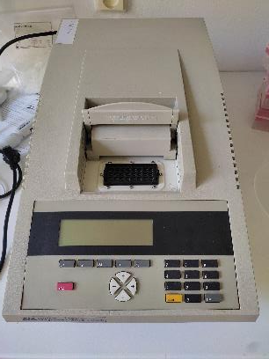
Multiblock thermocycler
2019
2001

Slide 7
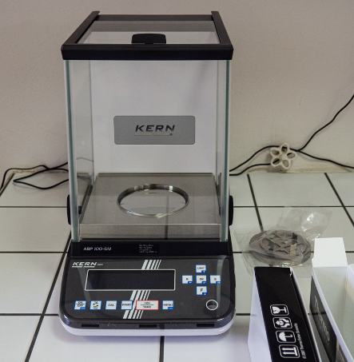
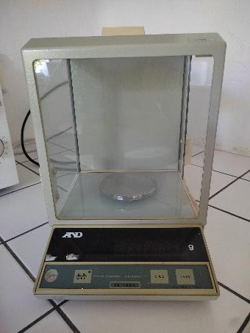
Analytical weights
1985

Slide 8
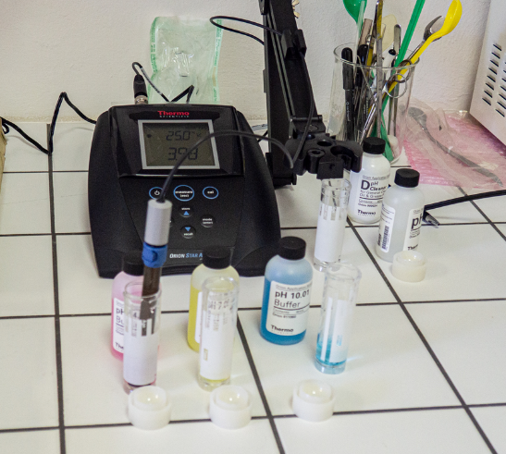
pH meter with flat probe

Slide 9
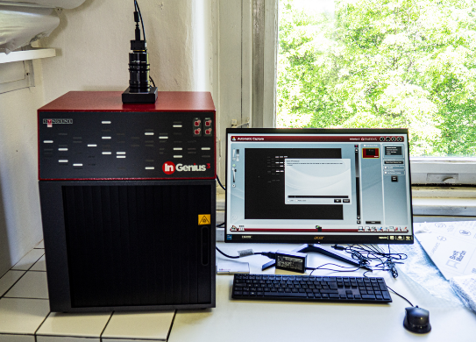

Photographic equipment for recording electrophoresis results

Slide 10
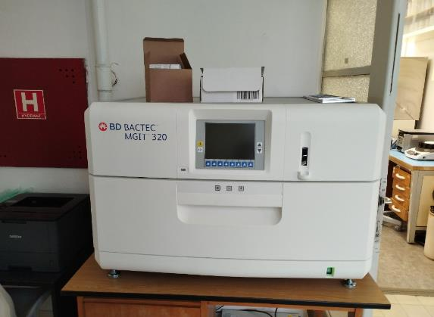
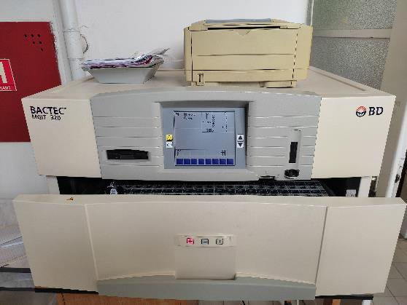
BACTEC MGIT
2013

Slide 11
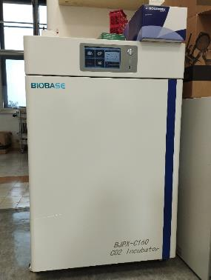
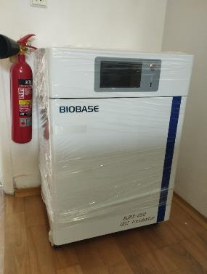
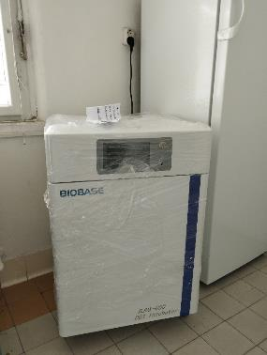
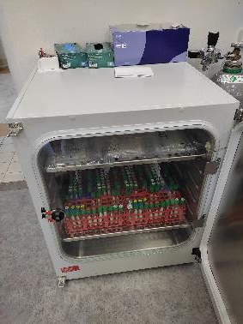
CO₂ incubators
2023

Slide 12
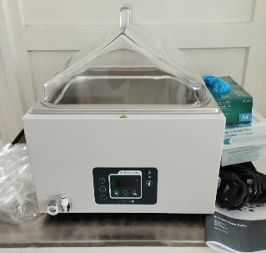
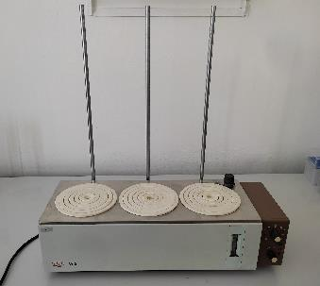
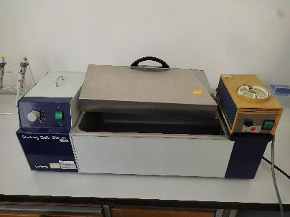
Water baths
1985

Slide 13
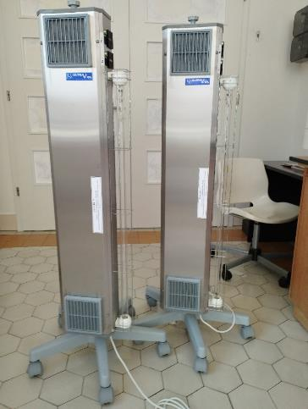
UV lamps

Slide 14
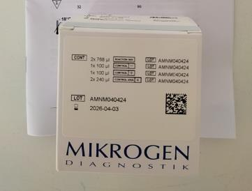
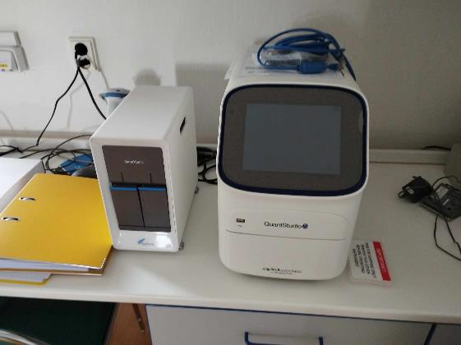
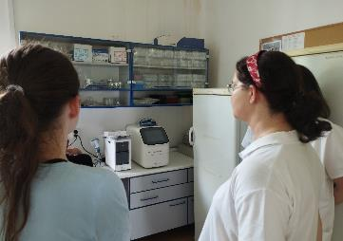
Real Time PCR cycler and GeneXpert molecular diagnostic platform

Slide 15
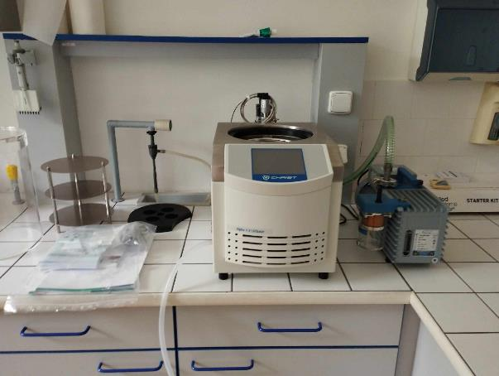
Lyophilization equipment

Slide 16
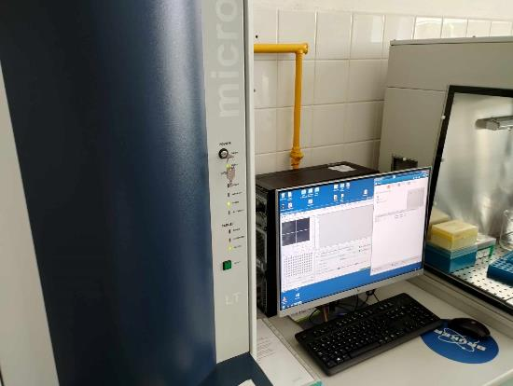
Maldi-tof DATABASE

Slide 17
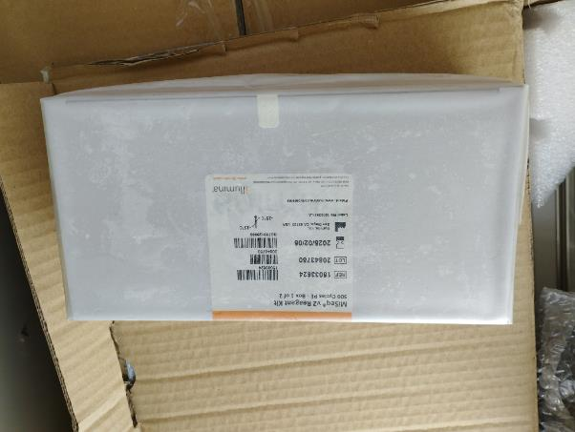
Illumina MYC-TB Combo Kit

Slide 20
Other scientific projects in NRLM
Screening and genomic characterization of M. tuberculosis strains obtained from children and comparison between war refugees and migrants from Ukraine
Distribution MIC in all mycobactieria from 2011 to 2023 for all tested at/atb in nrlm
Screening and genomic characterization of M. tuberculosis strains with a MIC for pretomanid
Investigation of regulatory regions for rifampicin, delamanid and pretomanid
Screening and genomic characterization of MAC strains
Submitted study (YEAR 2024):
Resistance profiling and transmission of Mycobacterium abscessus subspecies from cystic fibrosis and non-cystic fibrosis patients: A prospective countrywide study
Mycobacterial HelD is a global transcription regulator and is associated with increased rifampicin resistance in clinical isolates

Slide 21
Screening and genomic characterization of M. tuberculosis strains obtained from war refugees and migrants from Ukraine
8.11.2023
Tuberculosis in Ukrainian war refugees and migrants in the Czech Republic and Slovakia: a molecular epidemiological study has been accepted for publication in Journal of Epidemiology and Global Health (IF: 7.3)
11.3.2024
TB index case tracing in the Roma community in the Czech Republic (published in Epidemiology & Infection , Volume 152)

Slide 22


Future scientific projects
Nanopore sequcing, M. xenopi, transmission of resistant TB in the Czech population after 2021 etc.
Co-workers:
Matúš Dohál (from Jeseni University), Jarmila Hnilicová (from charles university), Jana Amlerová, Andrea Spitaleri, Federico di Marco, Michael E. Rasmussen, Igor Provazník, Ivan Solovič, Daniela M. Cirillo, Juraj Mokrý

Slide 23


Thank you for your attention
vera.dvorakova@szu.cz

